Slide 1
Basic Structures: Sets, Functions, Sequences, Sums
Chapter 2

Slide 2
Sets
Section 2.1

Slide 3
Video 15: Introduction to Sets
Sets
Specification of sets
Sets of Numbers
Special sets

Slide 4
Introduction
Sets are one of the basic building blocks in discrete mathematics.
Important for counting.
Programming languages have set operations.
Set theory is an important branch of mathematics.
Many different systems of axioms have been used to develop set theory.
Here we are not concerned with a formal set of axioms for set theory.
Instead, we will use what is called naïve set theory.

Slide 5
Sets
A set is an unordered collection of objects.
the students in this class
the chairs in this room
The objects in a set are called the elements of the set.
A set is said to contain its elements.
The notation a ∈ A denotes that a is an element of the set A.
If a is not an element of A, write a ∉ A

Slide 6
Describing a Set: Roster Method
Listing all elements of a set
S = {a, b, c, d}
Order not important: S = {a, b, c, d} = {b, c, a, d}
Multiple occurrences not important: S = {a, b, c, d} = {a, b, c, b, c, d}
Elipses (…) may be used to describe a set without listing all of the members when the pattern is clear
S = {a, b, c, d, ……, z}

Slide 7
Examples
Set of all vowels in the English alphabet:
V = {a, e, i, o, u}
Set of all odd positive integers less than 10:
O = {1, 3, 5, 7, 9}
Set of all positive integers less than 100:
S = {1, 2, 3,…….., 99}
Set of all integers less than 0:
S = {…., -3, -2, -1}

Slide 8
Sets of Numbers
N = natural numbers = {0, 1, 2, 3, ….}
Z = integers = {…, -3, -2, -1, 0, 1, 2, 3, …}
Z⁺ = positive integers = {1, 2, 3, …..}
R = set of real numbers
R⁺ = set of positive real numbers
C = set of complex numbers
Q = set of rational numbers

Slide 9
Set-Builder Notation
Specify the property or properties that all members must satisfy:
S = {x | P(x)}
P(x) may be expressed in natural language or predicate logic

Slide 10
Examples
S = {x | x is a positive integer less than 100}
O₁ = {x | x is an odd positive integer less than 10}
O₂ = {x ∈ Z⁺ | x is odd and x < 10}
P = {x | Prime(x)}
Q⁺ = {x ∈ R | x = p/q, for some positive integers p, q}

Slide 11
Interval Notation
For sets of numbers
[a,b] = {x | a ≤ x ≤ b}
[a,b) = {x | a ≤ x < b}
(a,b] = {x | a < x ≤ b}
(a,b) = {x | a < x < b}
closed interval [a,b]
open interval (a,b)

Slide 12
Universal Set and Empty Set
The universal set U is the set containing everything currently under consideration.
Sometimes implicit
Sometimes explicitly stated
Contents depend on the context
The empty set is the set with no elements.
Denoted as ∅ or {}

Slide 13
Some things to remember
Sets can be elements of sets.
{{1, 2, 3}, a, {b, c}}
{N ,Z, Q, R}
The empty set is different from a set containing the empty set.
∅ ≠ { ∅ }

Slide 14
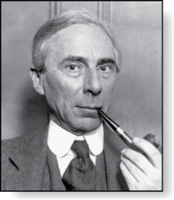
Russell’s Paradox
Let S be the set of all sets which are not members of themselves.
A paradox results from trying to answer the question
“Is S a member of itself?”
Bertrand Russell (1872-1970)
Cambridge, UK
Nobel Prize Winner

Slide 15
Summary
Set definition
Roster method
Set Builder Notation
Sets of Numbers
Interval Notation
Empty and Universal Set

Slide 16
Video 16: More on Sets
Set equality
Subsets
Proper subsets

Slide 17
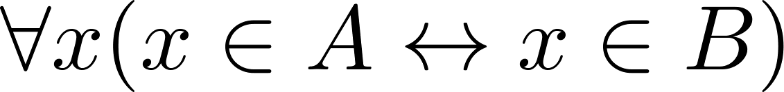
Set Equality
Definition: Two sets A and B are equal if and only if A and B have the same elements.
We write A = B if A and B are equal sets.
If A and B are sets, then A and B are equal if and only if

Slide 18
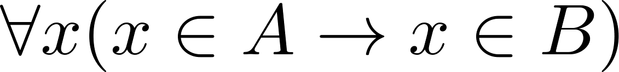
Subsets
Definition: The set A is a subset of B, if and only if every element of A is also an element of B.
We write A ⊆ B if A is a subset of B.
A ⊆ B holds if and only if
Because a ∈ ∅ is always false, ∅ ⊆ S , for every set S.
Because a ∈ S → a ∈ S, S ⊆ S, for every set S.

Slide 19
Proper Subsets
Definition: If A ⊆ B, but A ≠B, then we say A is a proper subset of B if and only if
We write A ⊂ B if A is a proper subset of B.

Slide 20
Showing a Set is a Subset of Another Set
Showing that A is a Subset of B: To show that A ⊆ B, show that if x belongs to A, then x also belongs to B.
Showing that A is not a Subset of B: To show that A is not a subset of B, A ⊈ B, find an element x ∈ A with x ∉ B (a counterexample).
Showing that A is a proper Subset of B: To show that A is a proper subset of B, A ⊂ B , show that A is a subset of B and find an element x ∈ B with x ∉ A (a witness).

Slide 21
Examples
The set of all odd positive integers less than 10 is a subset of the set of all positive integers less than 10.
positive(x) ∧ odd(x) → positive(x)
The set of all odd positive integers less than 10 is a proper subset of the set of all positive integers less than 10.
Witness: 2
The set of integers with squares less than 100 is not a subset of the set of nonnegative integers.
Counterexample: -1

Slide 22
Showing Equality of Sets
Recall that two sets A and B are equal, denoted by A = B, iff
Using logical equivalences we have that A = B iff
This is equivalent to A ⊆ B and B ⊆ A.

Slide 23
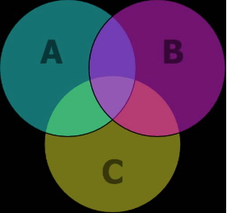
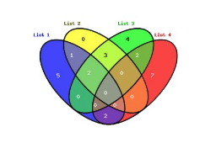
Venn Diagrams
Venn diagrams are pictures of sets, drawn as subsets of some universal set U.
May be used for pictorial purposes, but never for proofs.
U
B
A
A ⊆ B

Slide 24
Summary
Set equality
Subsets
Proper subsets
How to show these relations
How to illustrate these relations: Venn Diagrams

Slide 25
Video 17: Constructing Sets
How to build new sets from existing sets
Size of sets

Slide 26
Power Sets
Definition: The set of all subsets of a set A, denoted P(A), is called the power set of A.
Example: If A = {a, b} then
P(A) = {ø, {a}, {b}, {a,b}}

Slide 27
Tuples
Definition: The ordered n-tuple (a₁, a₂, ….., a_{n}) is the ordered collection that has a₁ as its first element and a₂ as its second element and so on until a_{n} as its last element.
Two n-tuples are equal if and only if their corresponding elements are equal. (a₁, a₂, ….., a_{n}) = (b₁, b₂, ….., b_{n}) iff. a₁ = b₁ and … and a_{n} = b_{n}
2-tuples are called ordered pairs.

Slide 28
Cartesian Product
Definition: The Cartesian Product of two sets A and B, denoted by A × B, is the set of ordered pairs (a, b) where a ∈ A and b ∈ B
Definition: A subset R of the Cartesian product A × B is called a relation from the set A to the set B.

Slide 29
Example
A = {a, b} B = {1, 2, 3}
Cartesian Product:
A × B = {(a, 1) , (a, 2), (a, 3), (b, 1), (b, 2), (b, 3)}
A relation:
R = {(a, 1) , (a, 2), (b, 2), (b, 3)}
Note: In general A × B is not equal to B × A

Slide 30
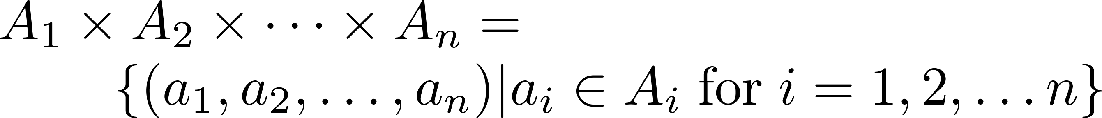
Cartesian Product
Definition: The Cartesian Products of the sets A₁, A₂, ……, A_{n}, denoted by A₁ × A₂ × …… × A_{n} , is the set of ordered n-tuples (a₁, a₂,……, a_{n}) where a_{i} belongs to A_{i} for i = 1, … n.

Slide 31
Example
A × B × C where A = {0, 1}, B = {1, 2} and C = {0, 1, 2}
A × B × C =
{(0,1,0), (0,1,1), (0,1,2),(0,2,0), (0,2,1), (0,2,2),(1,1,0), (1,1,1), (1,1,2), (1,2,0), (1,2,1), (1,2,2)}

Slide 32
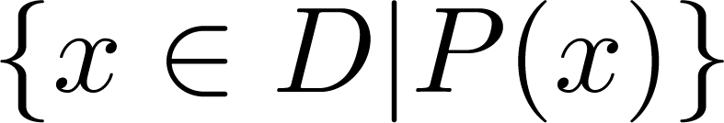
Truth Sets of Quantifiers
Definition: Given a predicate P and a domain D, we define the truth set of P to be the set of elements in D for which P(x) is true.
The truth set of P(x) is denoted by
Example: The truth set of P(x) where the domain is the integers and P(x) := |x| = 1 is the set {-1, 1}

Slide 33
Set Cardinality
Definition: If there are exactly n distinct elements in a set S where n is a nonnegative integer, we say that S is finite. Otherwise it is infinite.
Definition: The cardinality of a finite set S, denoted by |S|, is the number of (distinct) elements of S.

Slide 34
Examples
|ø| = 0
Let S be the letters of the English alphabet. Then |S| = 26
|{1,2,3}| = 3
|{ø}| = 1
The set of integers is infinite.
If a set has n elements, then the cardinality of the power set is 2ⁿ.
If |A| = n and |B| = m, then |A × B| = n*m.

Slide 35
Summary
Power sets
Tuples and Cartesian Product
Cardinality of sets

Slide 36
Set Operations
Section 2.2

Slide 37
Video 18: Set Operations
Set Operations
Union
Intersection
Complementation
Difference
Symmetric Difference

Slide 38
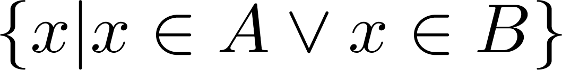
Union
Definition: Let A and B be sets. The union of the sets A and B, denoted by A ∪ B, is the set:
Example: {1, 2, 3} ∪ {3, 4, 5} = {1, 2, 3, 4, 5}
Venn Diagram for A ∪ B
U
A
B

Slide 39
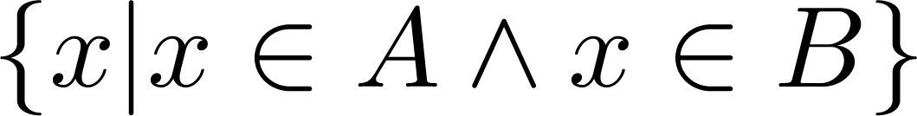
Intersection
Definition: The intersection of sets A and B, denoted by A ∩ B, is
If the intersection is empty, then A and B are said to be disjoint.
Example: {1, 2, 3} ∩ {3, 4, 5} = {3}
{1, 2, 3} ∩ {4, 5, 6} = ∅
Venn Diagram for A ∩B
U
A
B

Slide 40
Difference
Definition: The difference of sets A and B, denoted by A – B, is the set containing the elements of A that are not in B.
A – B = {x | x ∈ A ∧ x ∉ B} = A ∩‾B
The difference of A and B is also called the complement of B with respect to A.
Example: {1, 2, 3} – {3, 4, 5} = {1, 2}
Venn Diagram for A − B
U
A
B

Slide 41
Complement
Definition: If A is a set, then the complement of the A with respect to the universe U, denoted by Ā is the set
Ā = U – A = {x ∈ U | x ∉ A}
The complement of A is also denoted by A^{c} .
Example: If U is the positive integers, {x | x > 70}^{c} = {x | x ≤ 70}
Venn Diagram for Complement
Ā
U
A

Slide 42
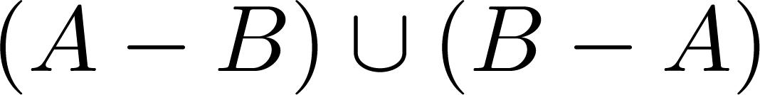

Symmetric Difference
Definition: The symmetric difference of sets A and B, denoted by A⊕B is the set
Example: A = {1, 2, 3, 4, 5} , B ={4, 5, 6, 7, 8}, A⊕B = {1, 2, 3, 6, 7, 8}
Venn Diagram
U
A
B

Slide 43
Analogy Set Operations – Propositional Calculus Connectives
∪ corresponds to ∨ A ∪ B = {x|x ∈ A ∨ x ∈ B}
∩ corresponds to ∧ A ∩ B = {x|x ∈ A ∧ x ∈ B}
Ā corresponds to ¬ Ā = {x ∈ U | ¬ x ∈ A} = {x ∈ U | ¬ x ∉ A}
⊕ corresponds to ⊕ A ⊕ B = {x|x ∈ A ⊕ x ∈ B}

Slide 44
Cardinality of Set Union
Inclusion-Exclusion
|A ∪ B| = |A| + | B| − |A ∩ B|
Venn Diagram for A, B, A ∩ B, A ∪ B
U
A
B

Slide 45
Summary
Set Operations
Analogy to Propositional Logic
Inclusion-Exclusion

Slide 46
Video 19: Set Identities
Set Identities
Proving set identities

Slide 47
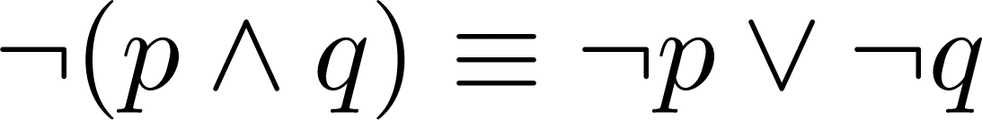
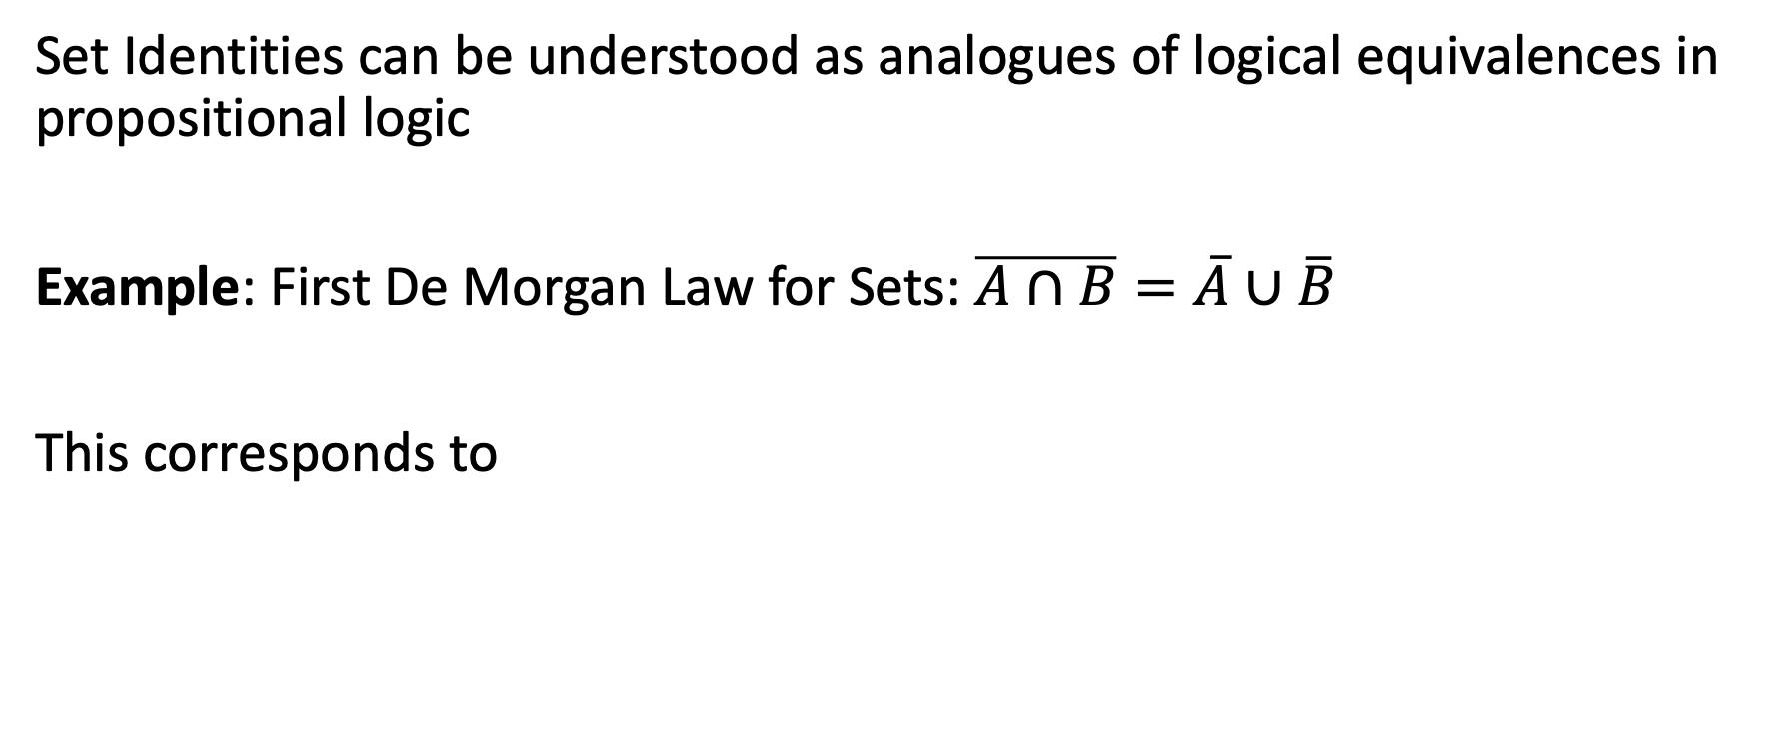
Set Identities
Set Identities can be understood as analogues of logical equivalences in propositional logic
Example: First De Morgan Law for Sets: $\overline{A∩B}=\overline{A}∪\overline{B}$
This corresponds to

Slide 48
Proving Set Identities
Different approaches to prove set identities
Use set builder notation and propositional logic.
Prove that each set (side of the identity) is a subset of the other.
Membership Tables: Verify that elements in the same combination of sets always either belong or do not belong to the same side of the identity.

Slide 49
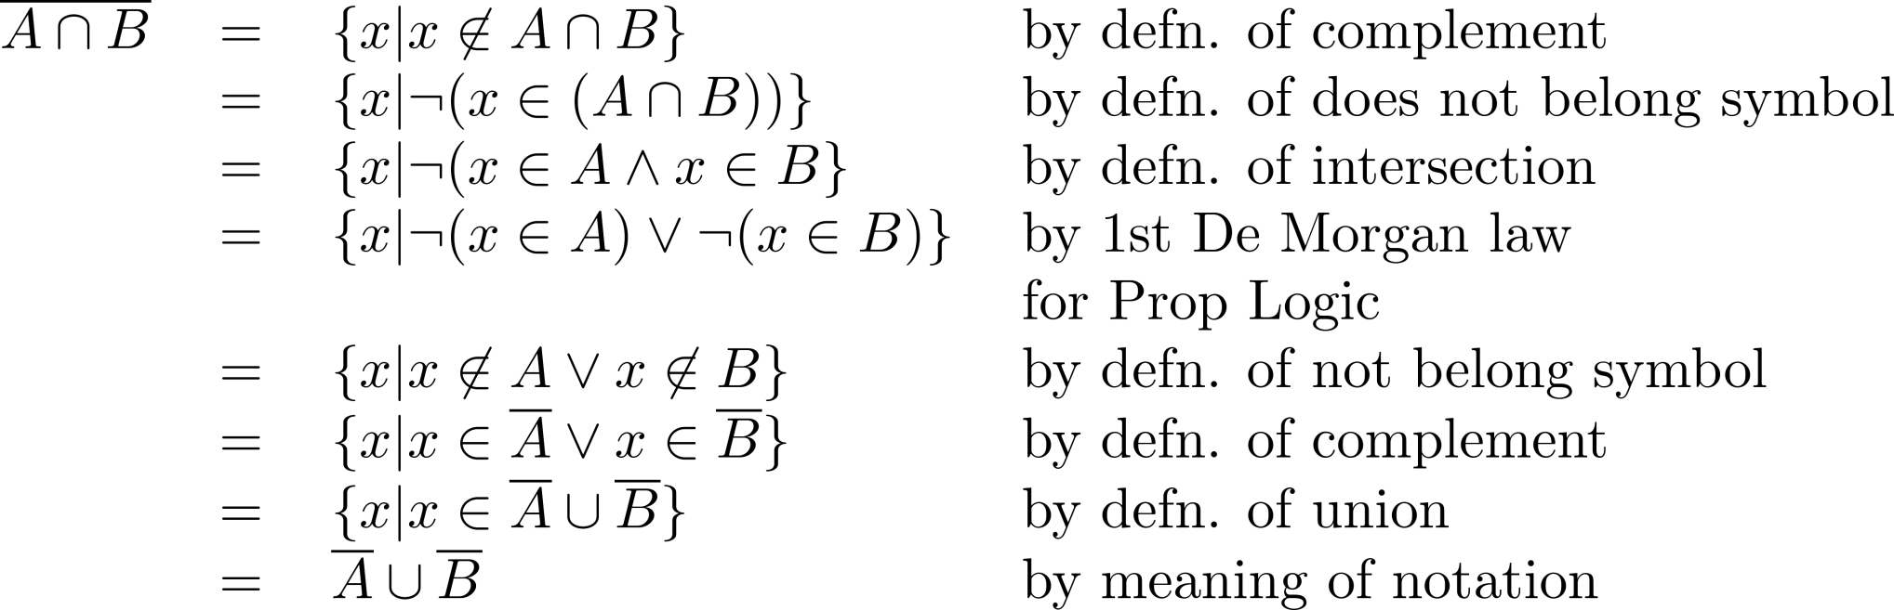
Set-Builder Notation: First De Morgan Law

Slide 50


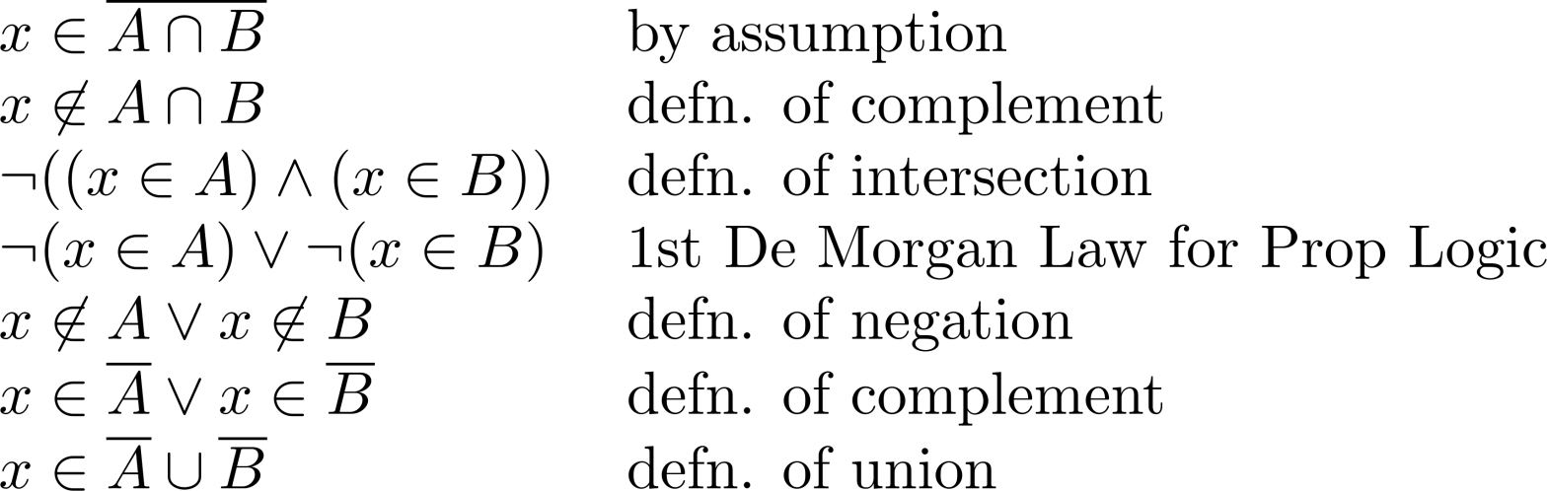
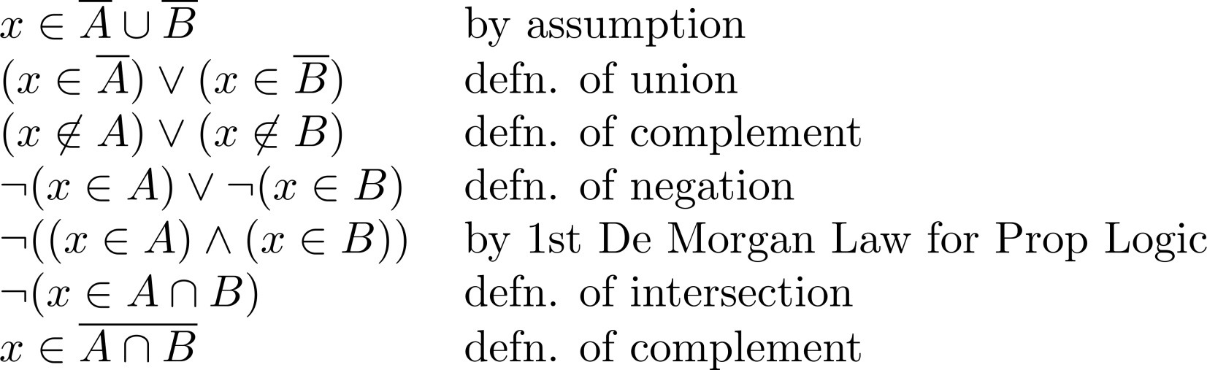
Alternative Proof

Slide 51
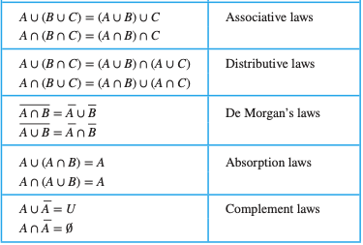
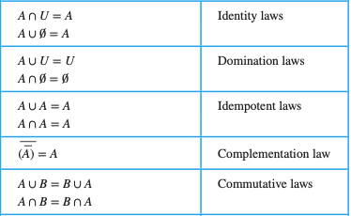
List of Set Identities
Note: they have all correspondents in propositional logic, and carry the same name

Slide 52





Proof by Membership table
Construct a membership table to show that the distributive law holds.
A | B | C
1 | 1 | 1 | 1 | 1 | 1 | 1 | 1
1 | 1 | 0 | 0 | 1 | 1 | 1 | 1
1 | 0 | 1 | 0 | 1 | 1 | 1 | 1
1 | 0 | 0 | 0 | 1 | 1 | 1 | 1
0 | 1 | 1 | 1 | 1 | 1 | 1 | 1
0 | 1 | 0 | 0 | 0 | 1 | 0 | 0
0 | 0 | 1 | 0 | 0 | 0 | 1 | 0
0 | 0 | 0 | 0 | 0 | 0 | 0 | 0
Note: you can read the column name A as the predicate x ∈ A

Slide 53
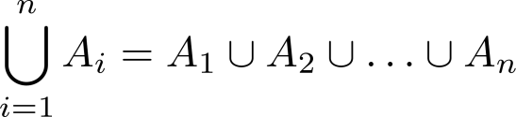
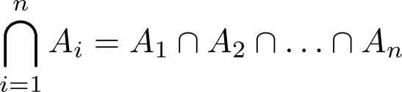
Generalized Unions and Intersections
Since union and intersection are associative, we can introduce the following notations
Let A₁, A₂ ,…, A_{n} be an indexed collection of sets.

Slide 54
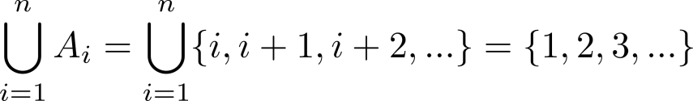
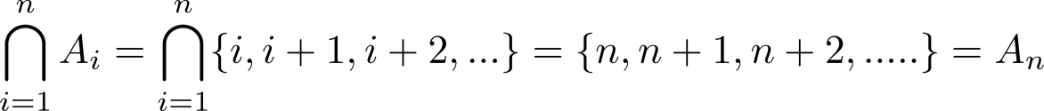
Example
For i = 1, 2, …, let A_{i} = {i, i + 1, i + 2, ….}. Then,

Slide 55
Summary
Set identities as analogous to propositional logical equivalences
Proof by
Set builder notation
Subset relationship
Truth table
Generalised union and intersection

Slide 56
Functions
Section 2.3

Slide 57
Video 20: Introduction to Functions
Definition of a Function
Injection, Surjection, Bijection

Slide 58
Functions
Definition: Let A and B be nonempty sets. A function f from A to B is an assignment of exactly one element of B to each element of A.
If f is a function from A to B, we write f : A→B.
We write f (a) = b if b is the unique element of B assigned by the function f to the element a of A.
Functions are sometimes called mappings or transformations.

Slide 59
Example
Student
Section
(Student, Course)
Grade
Student
Sciper
Philippe
SIN
(Philippe, AICC1)
Philippe
123456
6
Maria
SSC
(Maria, Phy1)
Maria
234567
5
Delphine
SV
(Maria, AICC1)
Delphine
345678
4
Paul
(Paul, Phy2)
Paul
456789
3
2
000000

Slide 60
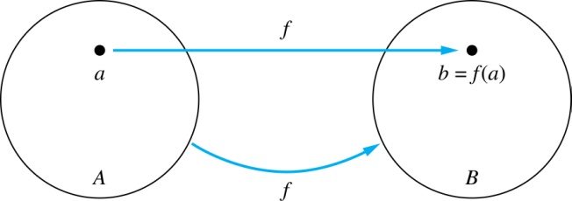
Functions - Terminology
Given a function f: A → B:
We say f maps A to B or f is a mapping from A to B
A is called the domain of f
B is called the codomain of f
If f(a) = b,
then b is called the image of a under f
a is called the preimage of b

Slide 61
Functions - Terminology
The range of f is the set of all images of points in A under f. We denote it by f(A).
If f: A → B and S is a subset of A, then f(S) = {f(s) | s ∈ S}
Two functions are equal when they have the same domain, the same codomain and map each element of the domain to the same element of the codomain.

Slide 62
Example
f(a) =
The image of d is
The domain of f is ?
The codomain of f is ?
The preimage of y is ?
The preimages of x are ?
f(A) = ?
f({a,b,c}) = ?
A
B
a
x
b
y
c
z
d
w

Slide 63
Representing Functions
Functions may be specified in different ways
An explicit statement of the assignment
Table of students and their grades
A formula
f(x) = x + 1
A computer program.
A Python program that when given an integer n, produces the Number 2^{n}

Slide 64
Injections
Definition: A function f is said to be one-to-one, or injective, if and only if f(a) = f(b) implies that a = b for all a and b in the domain of f.
A function is said to be an injection if it is one-to-one.
Why important?
Every Sciper number can only be assigned to one student.
Student
Sciper
Philippe
123456
Maria
234567
Delphine
345678
Paul
456789
000000

Slide 65
Surjections
Definition: A function f from A to B is called onto or surjective, if and only if for every element b ∈ B there is an element a ∈ A with f(a) = b.
A function f is called a surjection if it is onto.
Why important?
Every Section has at least one student.
Student
Section
Philippe
SIN
Maria
SSC
Delphine
SV
Paul

Slide 66
Bijections
Definition: A function f from A to B is a one-to-one correspondence, or a bijection, if it is both one-to-one and onto (surjective and injective).
Student
Sciper
Philippe
123456
Maria
234567
Delphine
345678
Paul
456789

Slide 67
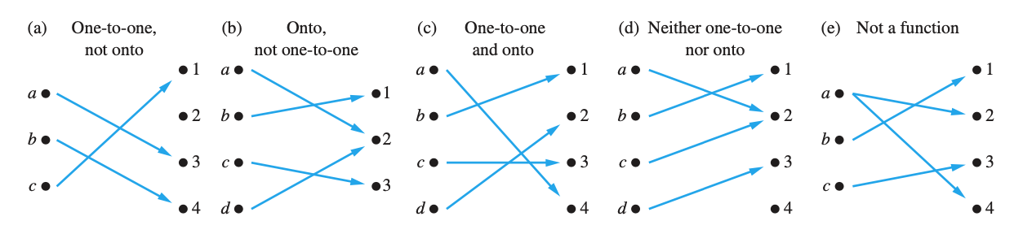
Illustration

Slide 68
Showing that f is injective
Let f: A → B be a function
To show that f is injective:
Select arbitrary x,y ∈ A,
Show that if f(x) = f(y), then x = y
To show that f is not injective:
Find x,y ∈ A such that x ≠ y and f(x) = f(y)

Slide 69
Showing that f is surjective
Let f: A → B be a function
To show that f is surjective:
Select arbitrary y ∈ B,
Find an element x ∈ A such that f(x) = y
To show that f is not surjective :
Find y ∈ B such that f(x) ≠ y for all x ∈ A

Slide 70
Example
Is the function f: Z → Z, f(x) = x+1 surjective? Yes preimage of y is y-1
Is the function f: N → N, f(x) = x+1 surjective? No 0 is no preimage
Is the function f: Z → Z, f(x) = x+1 injective? Yes if x≠y then x+1≠y+1
Is the function f: N → N, f(x) = x+1 injective? Yes if x≠y then x+1≠y+1
Is the function f: Z → Z, f(x) = x² surjective? No 3 has no preimage
Is the function f: Z → Z, f(x) = x² injective? No -1²=1²
Is the function f: N → N, f(x) = x² injective? Yes if x≠y then x² ≠ y²
N = natural numbers = {0, 1, 2, 3, ….}
Z = integers = {…, -3, -2, -1, 0, 1, 2, 3, …}

Slide 71
Summary
Definition of a Function
domain, co-domain, image, pre-image, range, equality
Injection, Surjection, Bijection
How to show these properties

Slide 72
Video 21: More on Functions
Inverse Function
Function Composition
Partial Functions
Graphs of Functions

Slide 73
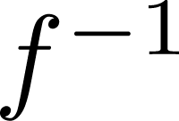
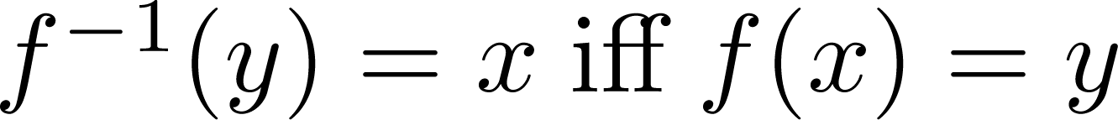
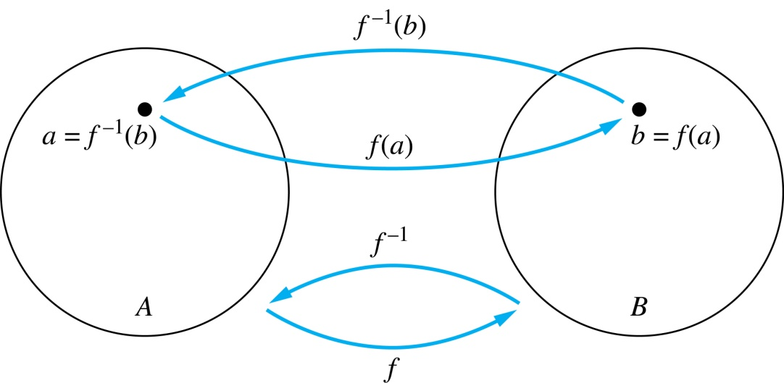
Inverse Functions
Definition: Let f be a bijection from A to B. Then the inverse of f, denoted , is the function from B to A defined as
No inverse exists unless f is a bijection. Why?

Slide 74
Example
A
B
A
B
f
f⁻¹
Student
Sciper
Student
Sciper
Philippe
123456
Philippe
123456
Maria
234567
Maria
234567
Delphine
345678
Delphine
345678

Slide 75
Example
Is the function f: Z → Z, f(x) = x+1 invertible? Yes
The inverse function is f⁻¹: Z → Z, f⁻¹(y) = y-1
Is the function f: R → R, f(x) = x² invertible? No
The function f is not one-to-one

Slide 76
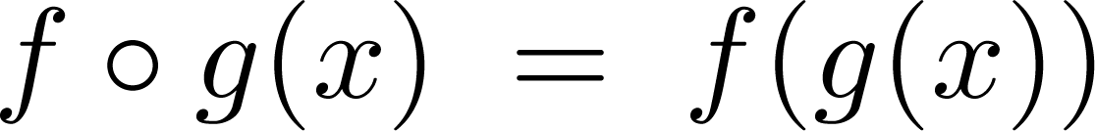
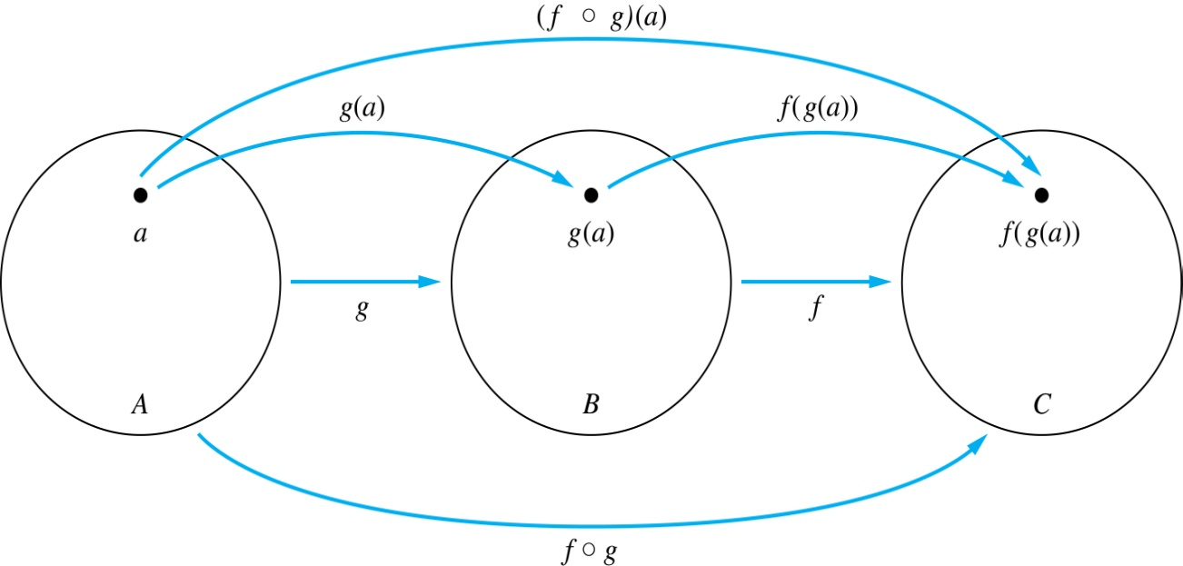
Composition
Definition: Let f: B → C, g: A → B. The composition of f with g, denoted f ○ g is the function from A to C defined by

Slide 77
Example
A
B
B
C
A
C
g
f
f ○ g
Student
Birthyear
Birthyear
Age
Student
Age
Philippe
1998
1998
22
Philippe
22
Maria
1999
1999
21
Maria
21
Delphine
2000
2000
20
Delphine
20
Paul
2001
2001
19
Paul
19
2002
2002
18
18

Slide 78
Example
If f(x) = x² and g(x) = x+1, then
f(g(x)) = (x+1)²
and
g(f(x)) = x²+1
Composition is not commutative!

Slide 79
Partial Functions
Definition: A partial function f from a set A to a set B is an assignment to each element a in a subset of A, called the domain of definition of f, of a unique element b in B.
The sets A and B are called the domain and codomain of f, respectively.
We say that f is undefined for elements in A that are not in the domain of definition of f.
When the domain of definition of f equals A, we say that f is a total function.

Slide 80
Example
f: Z → R where f(n) = √n is a partial function from Z to R where the domain of definition is the set of nonnegative integers.
The domain of definition of the function is N.
Note that f is undefined for negative integers.

Slide 81
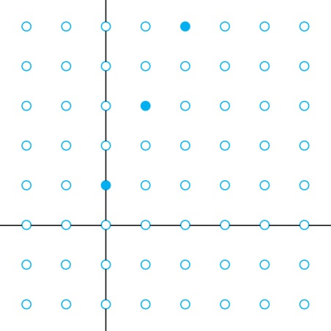
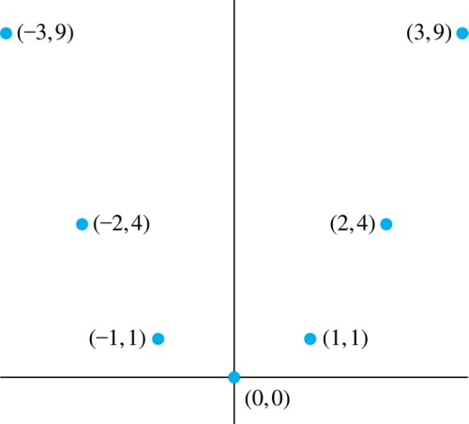
Graphs of Functions
Definition: Let f be a function from the set A to the set B. The graph of the function f is the set of ordered pairs {(a,b) | a ∈ A and f(a) = b}.
The graph can be used to illustrate the function pictorially!
Graph of f(n) = 2n + 1
from Z to Z
Graph of f(x) = x²
from Z to Z

Slide 82
Summary
Inverse Function
Only for bijections
Function Composition
Not commutative
Partial Functions
Graph of Functions

Slide 83
Relations
Chapter 9

Slide 84
Relations and Their Properties
Section 9.1

Slide 85
Video 22: Relations
Introduction to Relations
Operation on Relations

Slide 86
Binary Relations
Definition: A binary relation R from a set A to a set B is a subset R ⊆ A × B.
Example:
Let A = {0,1,2} and B = {a,b}
{(0, a), (0, b), (1,a) , (2, b)} is a relation from A to B.

Slide 87
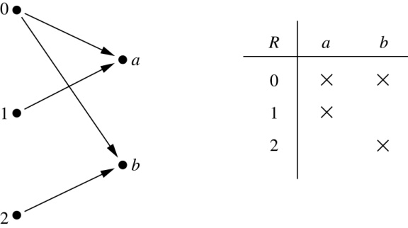
Representation of Relations
Possible representation of relations from a set A to a set B
directed graph
table

Slide 88
Functions and Relations
A function f : A → B can also be defined as a subset of A×B, i.e. as a relation.
A function f from A to B contains one, and only one ordered pair (a, b) for every element a ∈ A.
Relations are more general than functions!

Slide 89
Combining Relations
Given two relations R₁ and R₂, we can combine them using basic set operations to form new relations such as R₁ ∪ R₂, R₁ ∩ R₂, R₁ − R₂, and R₂ − R₁.
Example:
Let A = {1,2,3} and B = {1,2,3,4}.
Let R₁ = {(1,1),(2,2),(3,3)} and R₂ = {(1,1),(1,2),(1,3),(1,4)}
R₁ ∪ R₂ ={(1,1),(1,2),(1,3),(1,4),(2,2),(3,3)}
R₁ ∩ R₂ ={(1,1)}
R₁ − R₂ ={(2,2),(3,3)}
R₂ − R₁ ={(1,2),(1,3),(1,4)}

Slide 90
Composition of Relations
Definition: Let R be a relation from a set A to a set B. Let S be a relation from B to a set C.
The composite of R and S is the relation consisting of ordered pairs (a, c), where a ∈ A, c ∈ C, and for which there exists an element b ∈ B such that (a, b) ∈ R and (b, c) ∈ S.
We denote the composite of R and S by S ◦ R.

Slide 91
Example
R
S
m
w
a
x
n
b
y
o
c
p
z
S ∘ R = {(b, x), (b, z)}

Slide 92
N-ary Relations
Definition: Let A₁, A₂,..., A_{n} be sets. An n-ary relation on these sets is a subset of A₁ × A₂ ×⋯× A_{n}. The sets A₁, A₂, ... , A_{n} are called the domains of the relation, and n is called its degree.

Slide 93
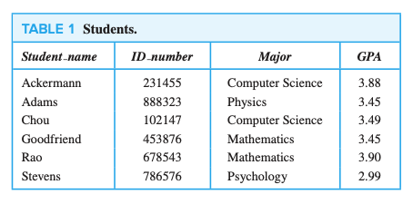
Example
Database tables are n-ary relations
Domains
Degree 4

Slide 94
Summary
Binary Relations
Set-operations on Relations
Composition of Relations
N-ary Relations

